Slide 1
LONG SHORT TERM MEMORY
By Vedant Sahai, Elvis Dsouza & Pratik Choudhary

Slide 2
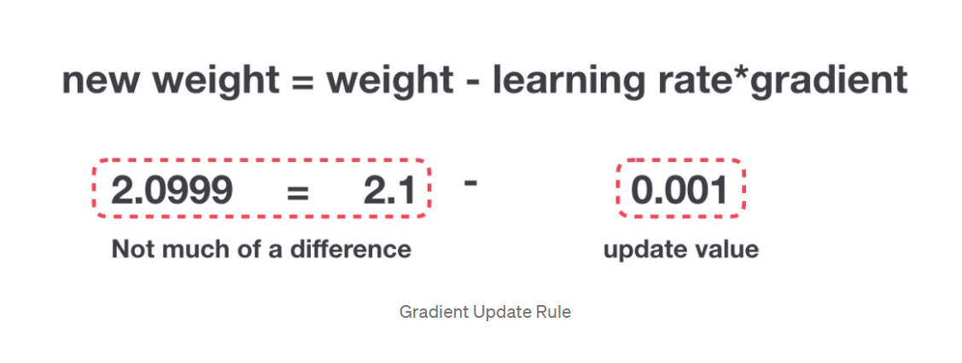
WHY LSTM ?
If a sequence is long enough, they’ll have a hard time carrying information from earlier time steps to later ones.
During back propagation, recurrent neural networks suffer from the vanishing gradient problem.
If a gradient value becomes extremely small, it doesn’t contribute too much learning.

Slide 3
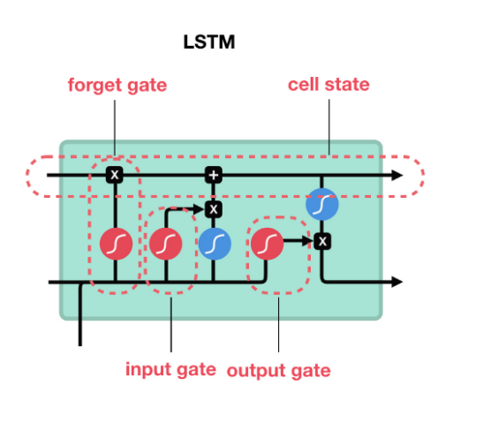
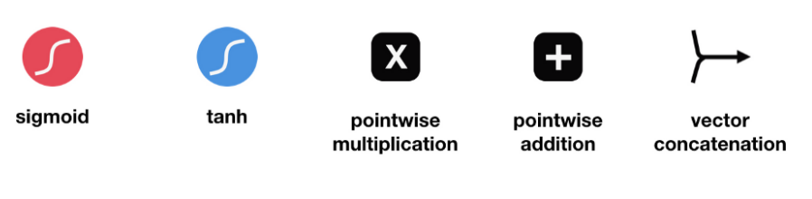
WHAT LSTM ?
Internal mechanisms called gates that can regulate the flow of information.
Gates can learn which data in a sequence is important to keep or throw away.
Pass relevant information down the long chain of sequences to make predictions.

Slide 4
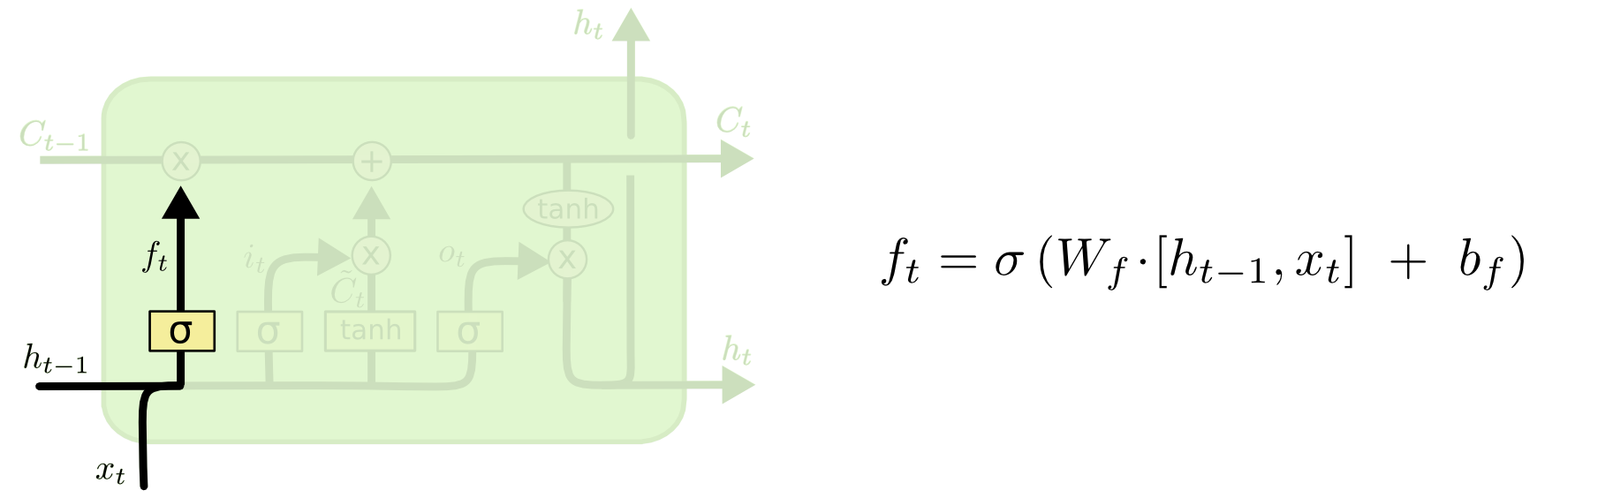
FORGET GATE
Gate Decides what information should be thrown away or kept

Slide 5
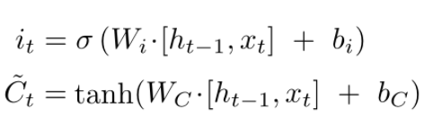
INPUT GATE
Gate regulate the network and decides which values will be updated by transforming the values to be between 0 and 1. 0

Slide 6
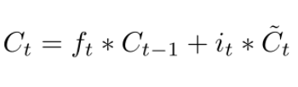
CELL GATE
Gate decides the possibility of dropping values and find new cell state values that the neural network finds relevant.

Slide 7
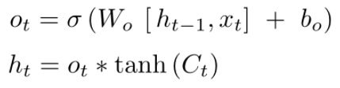
OUTPUT GATE
Gate decides what the next hidden state should be.
Hidden state is also used for predictions.
The new cell state and the new hidden is then carried over to the next time step.

Slide 8
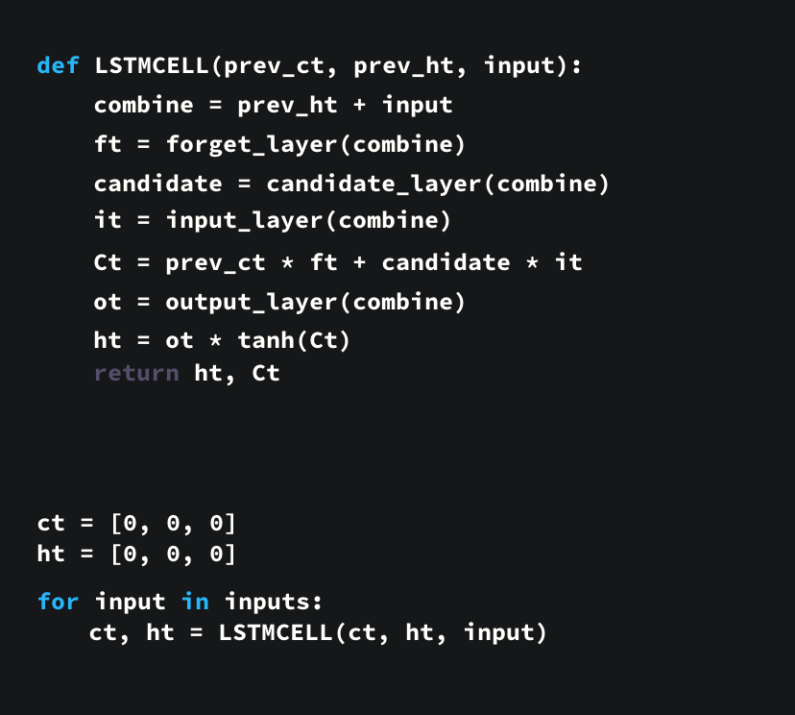
CODE DEMO
1. First, the previous hidden state and the current input get concatenated. We’ll call it combine. 2. Combine get’s fed into the forget layer. This layer removes non-relevant data. 4. A candidate layer is created using combine. The candidate holds possible values to add to the cell state. 3. Combine also get’s fed into the input layer. This layer decides what data from the candidate should be added to the new cell state. 5. After computing the forget layer, candidate layer, and the input layer, the cell state is calculated using those vectors and the previous cell state. 6. The output is then computed. 7. Pointwise multiplying the output and the new cell state gives us the new hidden state.

Slide 9
DISADVANTAGES
LSTMs became popular because they could solve the problem of vanishing gradients. But it turns out, they fail to remove it completely. The problem lies in the fact that the data still has to move from cell to cell for its evaluation. Moreover, the cell has become quite complex now with the additional features (such as forget gates) being brought into the picture.
They require a lot of resources and time to get trained and become ready for real-world applications. In technical terms, they need high memory-bandwidth because of linear layers present in each cell which the system usually fails to provide for. Thus, hardware-wise, LSTMs become quite inefficient.
With the rise of data mining, developers are looking for a model that can remember past information for a longer time than LSTMs. The source of inspiration for such kind of model is the human habit of dividing a given piece of information into small parts for easy remembrance.
LSTMs get affected by different random weight initializations and hence behave quite similar to that of a feed-forward neural net. They prefer small weight initializations instead.
LSTMs are prone to overfitting and it is difficult to apply the dropout algorithm to curb this issue. Dropout is a regularization method where input and recurrent connections to LSTM units are probabilistically excluded from activation and weight updates while training a network.

Slide 10
THANK YOU

